Slide 1
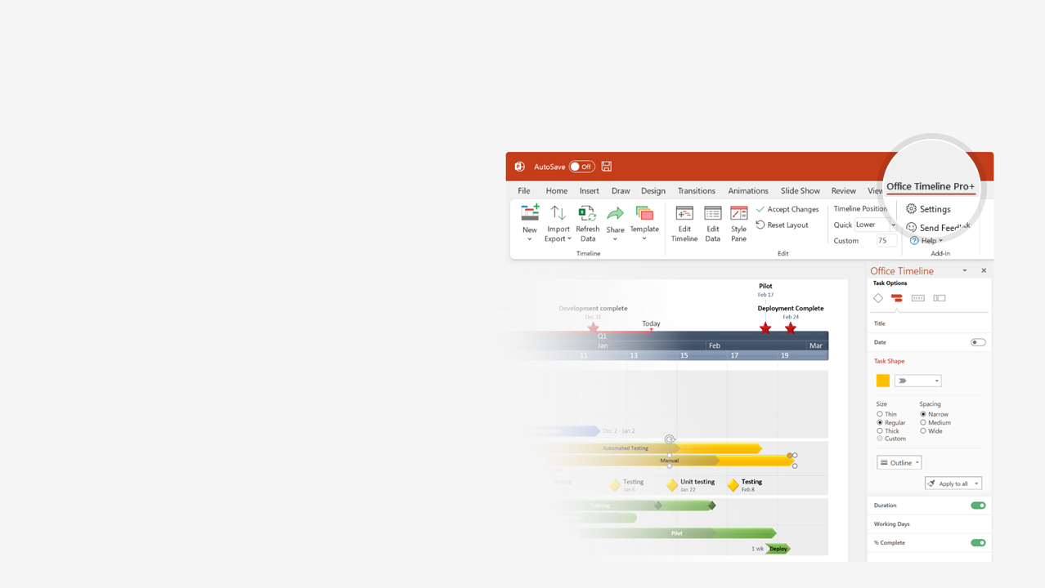

How to update this template in seconds
The Office Timeline add-in for PowerPoint will help you edit it with just a few clicks.
Get your free 14-day trial of Office Timeline here: https://www.officetimeline.com/office-timeline/14-days-trial Re-open this template, and create your impressive PowerPoint visual in 3 easy steps:
1
Click the Edit Data button on the Office Timeline tab.
2
Use the Data and Timeline views to edit swimlanes, milestones and tasks.
3
Click Save to instantly update the template.

Slide 2


1994
Today
2025
1994
1998
2002
2006
2010
2014
2018
2022
Amazon founded
Lawsuit against Barnes & Noble
1st physical store
Minimum wage raised to $15/h
1994
2002
2015
2018
IPOs at $18.00/share
Kindle e-books outsell hardcover books
$1 trillion market cap reached
25-year anniversary
Company Milestones
1997
2010
2018
2019
Expands beyond books
Amazon Launches in India
Search for 2nd HQ
announced
NY HQ plans scrapped
1998
2013
2017
2019
zShops launches
NY and Virginia to become Amazon HQ2
Jeff Bezos steps down
as CEO
1999
2018
2021
A9.com
Amazon Elastic Compute Cloud
Kindle Fire
2003
2006
2014
Product Launches
Amazon Prime
Amazon Fresh
Amazon Instant Video
Amazon Underground
2005
2007
2011
2015
Amazon Mechanical Turk
Amazon Music
Amazon Appstore
Amazon Prime Air
2005
2007
2011
2016
Amazon S3
Amazon Kindle
Amazon Care
2006
2007
2019
IMDB
Joyo
Zappos
GoodReads
Whole Foods
Acquisitions
1998
2004
2009
2013
2017
Audible
Kiva Systems
Twitch
PillPack
MGM
2008
2012
2014
2018
2022

