Slide 1
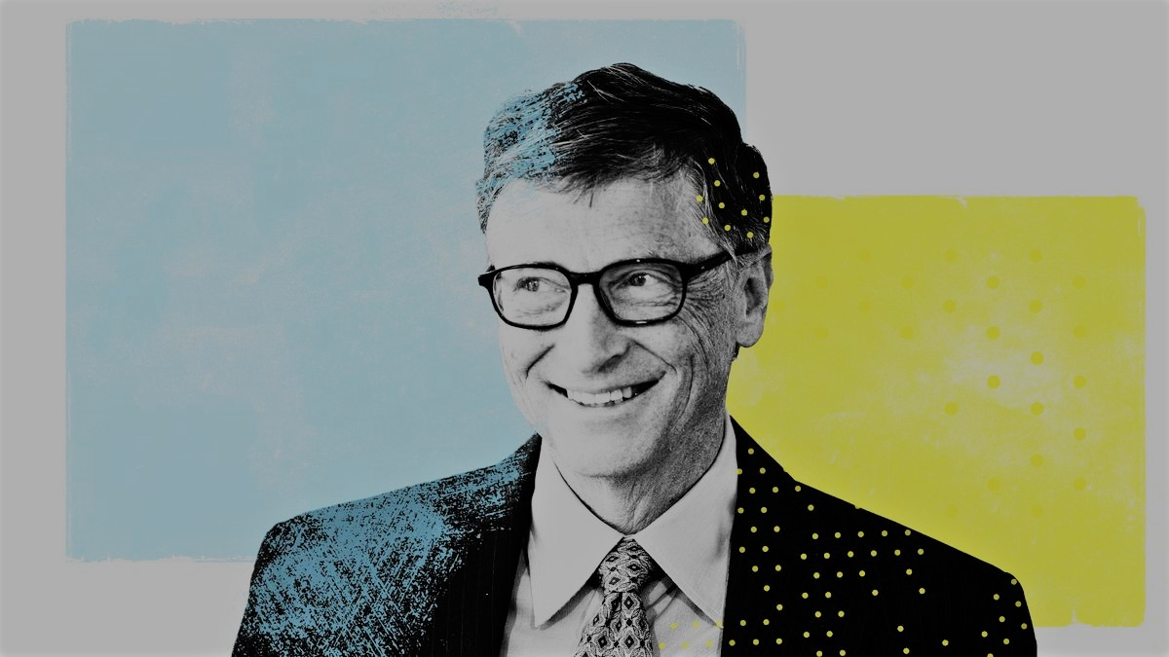
Business @ the Speed of Thought (book)
1999
Enrolls at Harvard College
The James C. Morgan Global Humanitarian Award
1973
2006
Becomes the youngest billionaire after MS goes public
Donates for improved healthcare in India
1987
2008
Partners with IBM to write the BASIC for the IBM PC
Founds The Bill & Melinda Gates Foundation
His 63rd birthday
1980
2000
Oct 28, 2018
William Henry Gates III is born
Drops out of college & co-founds Microsoft
Marries Melinda French
The Silver Buffalo Award
Oct 28, 1955
1975
1994
2010
1955
1955
1963
1971
1979
1987
1995
2003
2011
2018
1968
1981
1995
2009
Today
Enrolls at Lakeside School
Becomes president of Microsoft
The Road Ahead (book)
Co-founds The Giving Pledge
1989
2007
Founds Corbis
Receives honorary degree from Harvard
2005
Named Person of the Year by Time
2000
Steps down as CEO of Microsoft

