Slide 1
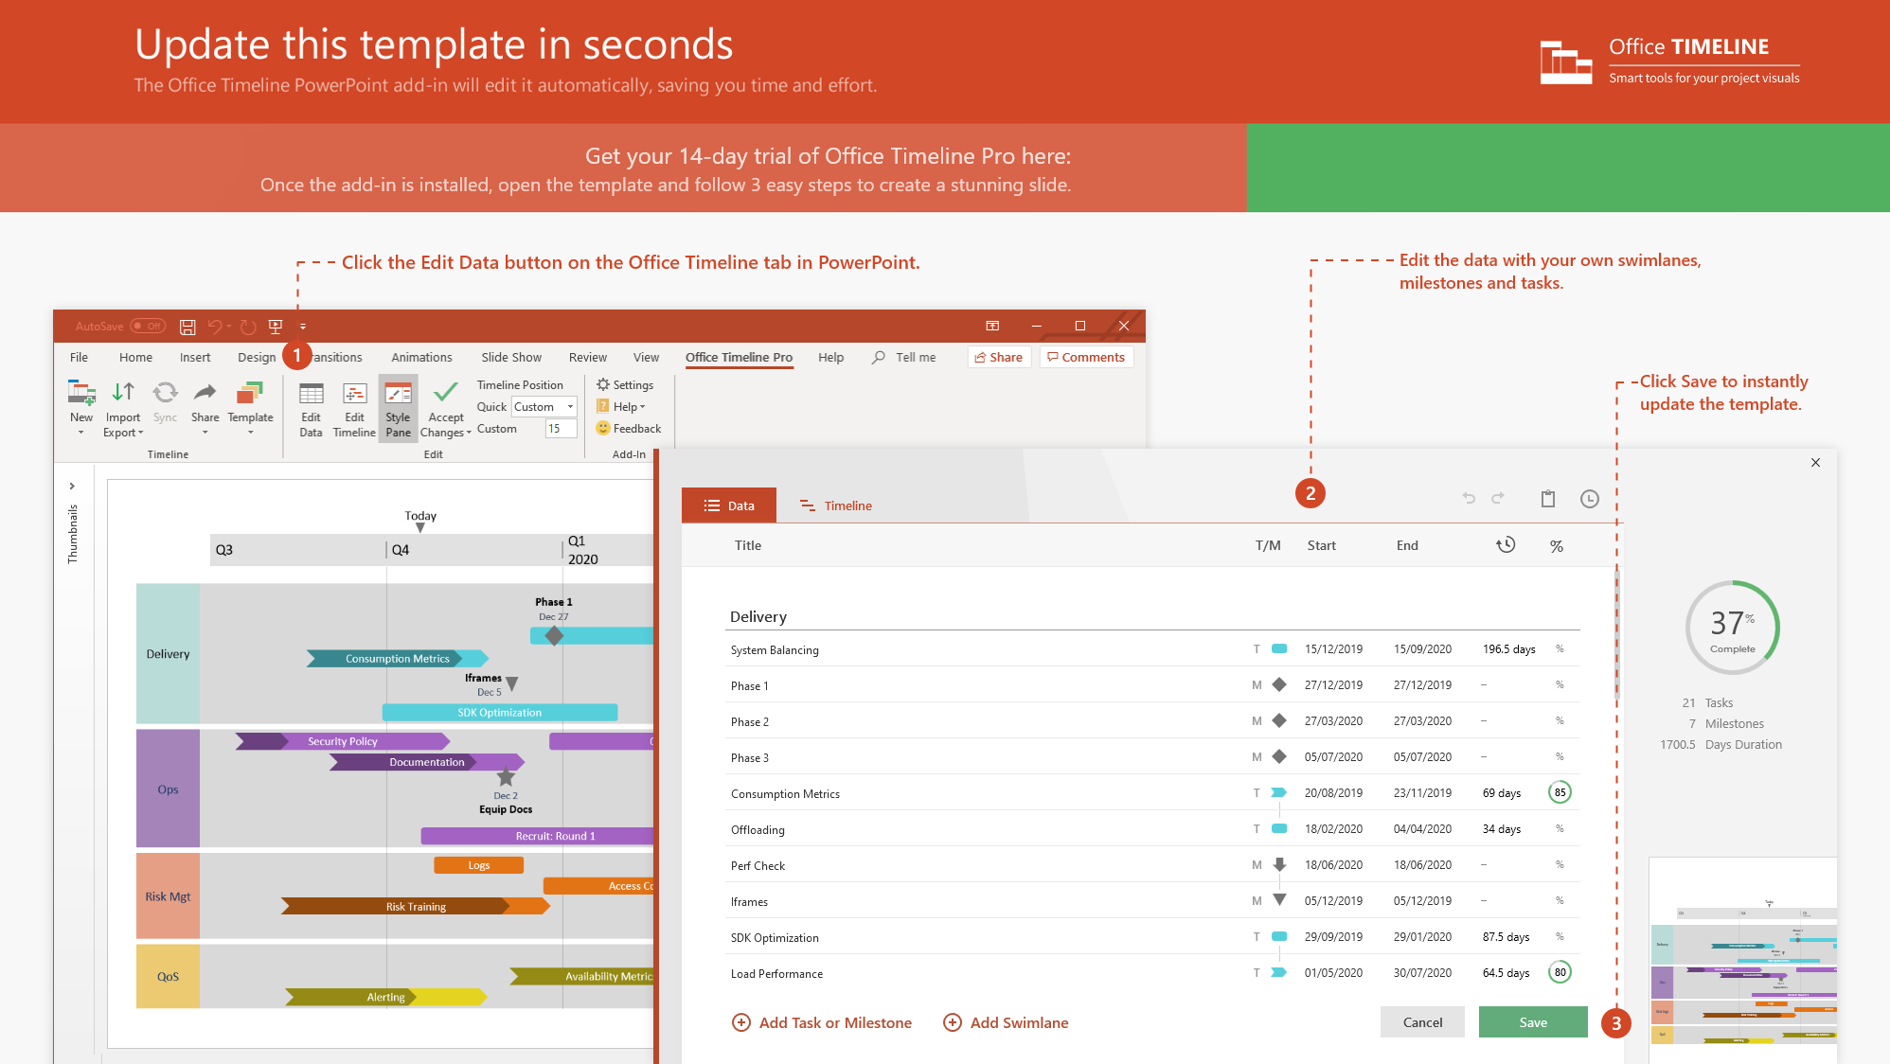
https://www.officetimeline.com/14-days-trial

Slide 2
911 call from shooting witness reporting gunfire at 700 Block Oswego Rd
13:30
Officers report gunshot victim behind building, no suspect found
13:45
Air unit called in for search
13:53
First officers arrive on scene
Suspect detained after ground chase at 740 Cedar Ave
13:34
14:19
Jan 24
13:00
14:00
Jan 24
Today
13:49
14:27
Victim carried to EMS
Shooting witness escorted to scene positively identifies suspect
13:31
Police dispatched
14:12
Suspect matching shooting witness description identified at Wingfoot Park
13:39
Shooting witness questioned on scene, gives full description of suspect

