Slide 1
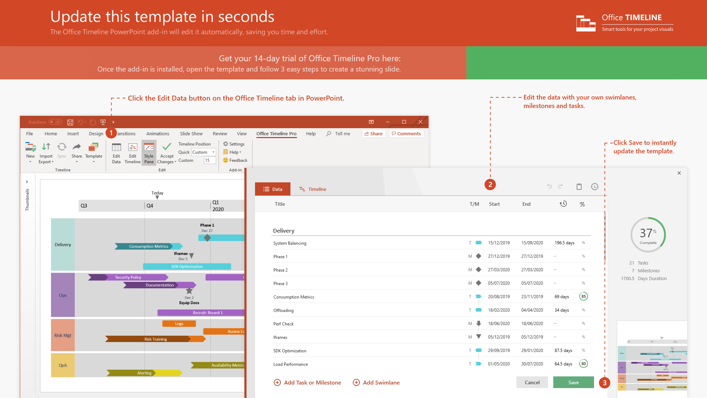
https://www.officetimeline.com/14-days-trial

Slide 2
0 hours
7:30 pm
9 pm
Time of assault
0 hours
7:30 pm
8:30 pm
Emanuel Spizer checks into Desert Motel in Graslin
0 hours
9 pm
2 am
Hotel guest in neighboring room hears no disturbances the rest of the night
May 16
4 pm
5 pm
6 pm
7 pm
8 pm
9 pm
10 pm
11 pm
12 am
1 am
May 17
Today
4:30 pm
8:22 pm
12:20 am
Tommy Smyth seen at Willowpoint Public Library 175 miles from Graslin
Hotel guest in neighboring room reports shouting in room next door
Smyth receives a speeding ticket 20 miles south of Pickering
7:17 pm
Smyth and Andy Borton take cell phone picture at Pickering Dairy Queen, 200 miles from Graslin

