Slide 1
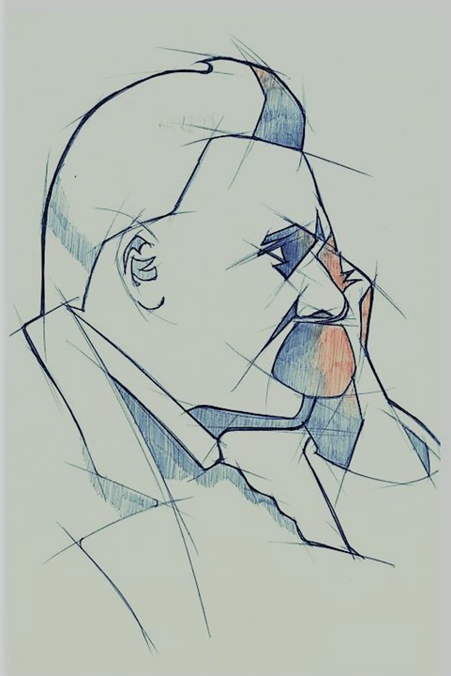
First attempts at musical compositions
1858
Graduates from respected Schulpforta
1864
Signs up for 1 year of voluntary military service
Twilight of the Idols
1867
1888
Becomes prof. of classical philology at the Univ. of Basel
Suffers mental breakdwon
1869
1889
The Birth of Tragedy
Thus Spoke Zarathustra
Suffers stroke, leaving him partially paralyzed
1872
1883
1898
1844
1844
1849
1854
1859
1864
1869
1874
1879
1884
1889
1894
1899
1903
Today
Oct 15, 1844
1865
1878
1888
Aug 25, 1900
Friedrich Wilhelm Nietzsche is born
Enrolls at the University of Leipzig
Human, All Too Human
Ecce Homo (posthumous)
Dies after having another stroke
1869
1890
Renounces his Prussian citizenship, remaining stateless
Taken into care by his mother
1868
1886
Meets & befriends Richard Wagner
Beyond Good and Evil
1860
Founds literary society 'Germania'
1854
Enrols at the Naumburg Domgymnasium
Life events
Works

