Slide 1
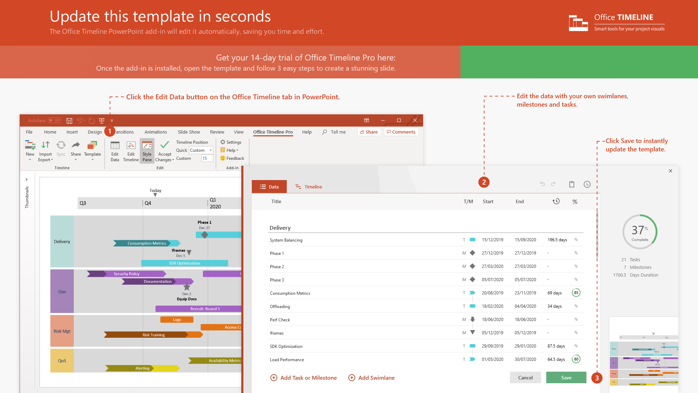
https://www.officetimeline.com/14-days-trial

Slide 2


smallpox
polio
hepatitis B
COVID-19
1796
1952
1981
2020
1790
1790
1819
1848
1877
1906
1935
1964
1993
2021
19th Century
cholera, rabies
1884 - 1885
tetanus, typhoid fever, bubonic plague
1890 - 1897
tuberculosis, diphtheria, scarlet fever, pertussis
1921 - 1926
yellow fever, typhus, influenza
1932 - 1937
20th Century
measles, mumps, rubella
1963 - 1970
chicken pox, pneumonia, meningitis
1974 - 1978
hepatitis A, Lyme disease, rotavirus
1991 - 1998
HPV
2006
hepatitis E
21st Century
2012
malaria, dengue fever
2015
Ebola
2019

