Slide 1
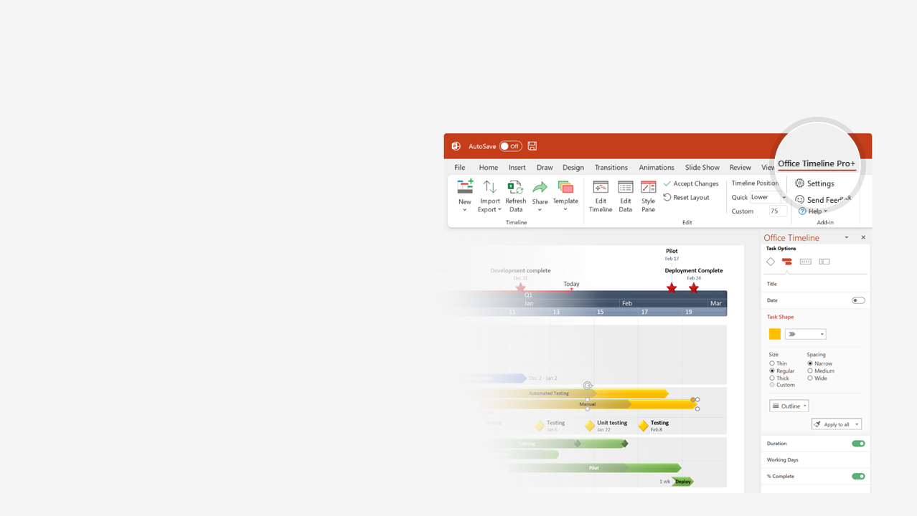

How to update this template in seconds
The Office Timeline add-in for PowerPoint will help you edit it with just a few clicks.
Get your free 14-day trial of Office Timeline here:
https://www.officetimeline.com/office-timeline/14-days-trial
Re-open this template, and create your impressive
PowerPoint visual in 3 easy steps:
1
Click the Edit Data button on the Office Timeline tab.
2
Use the Data and Timeline views to edit swimlanes, milestones and tasks.
3
Click Save to instantly update the template.

Slide 2
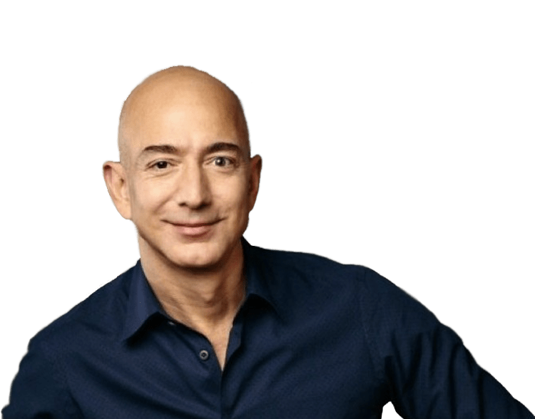

Jeffrey Preston Bezos is born
Founds Amazon as an online bookstore
To become world’s 1st trillionaire
January 12, 1964
1994
2026
1963
1969
1975
1981
1987
1993
1999
2005
2011
2017
2023
1993
2003
2019
Saudi hacking accusation
Marries novelist MacKenzie Tuttle
Helicopter crash in West Texas
Personal life
1994
2016
2019
Moves to Seattle
Stars in Star Trek Beyond
Divorces MacKenzie
1999
2019
Time Person of the Year
1st public appearance with Lauren Sanchez
1978
1986
Electrical engineering & computer science degrees from Princeton (Summa Cum Laude)
2008
Education
Enrolls at Miami Palmetto High School
Honorary doctorate from Carnegie Mellon Univ.
1982
Graduates from high school as valedictorian
1994
2000
2013
Founds Amazon as an online bookstore
Founds Blue Origin
Purchases The Washington Post
1988
1997
2017
Becomes world's wealthiest person
Career and
Wealth
Hired as product manager at Bankers Trust
Takes Amazon public
1998
2013
2021
Steps down as Amazon CEO
Diversifies Amazon's product range
Secures contract with CIA
2021
Loses title of wealthiest person to Elon Musk
2013
2018
$2bn Day 1 Families & Day 1 Academies
$500,000 Worldreader
Charity
2017
2020
$10bn Bezos
Earth Fund
$1m Reporters Committee for Freedom of the Press
2018
2021
$100m Obama Foundation
$33 m TheDream.US

