Slide 1
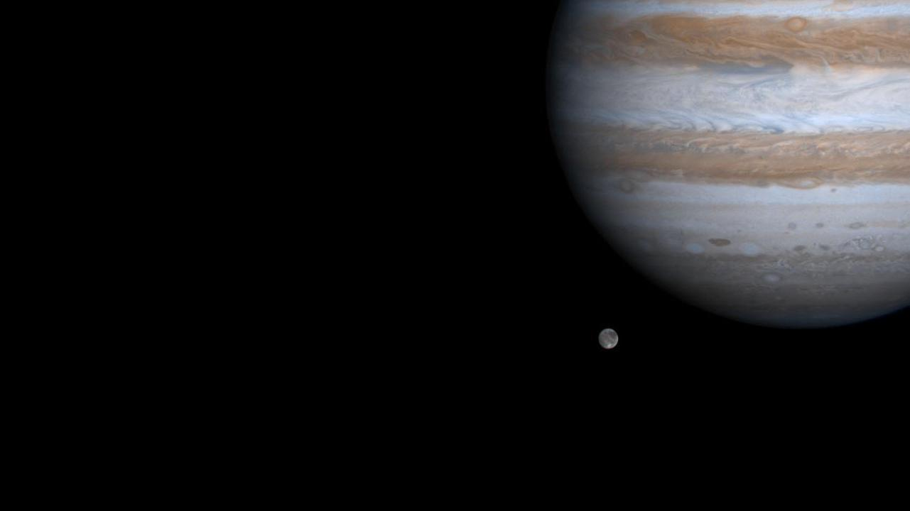
Perijove 2: engine issues
Oct 19, 2016
Perijove 4
Feb 2, 2017, 12:57
Perijove 6
May 19, 2017
Juno’s Launch
Jupiter arrival
Planned end of mission
Aug 5, 2011
Jul 5, 2016, 03:53
Feb 2018
2011
2011
2012
2013
2014
2015
2016
2017
2018
2019
2019
Oct 9, 2013
Sep 1, 2017
Earth flyby for speed boost
Earliest expected cam failure
Mar 27, 2017, 08:52
Perijove 5
Dec 11, 2016, 17:04
Perijove 3
Aug 27, 2016, 1:44 pm
Perijove 1
Deep space maneuvers
Aug 2012 - Sep 2012
Spacecraft disposal (controlled deorbit into Jupiter)
2018 - 2019

