Slide 1
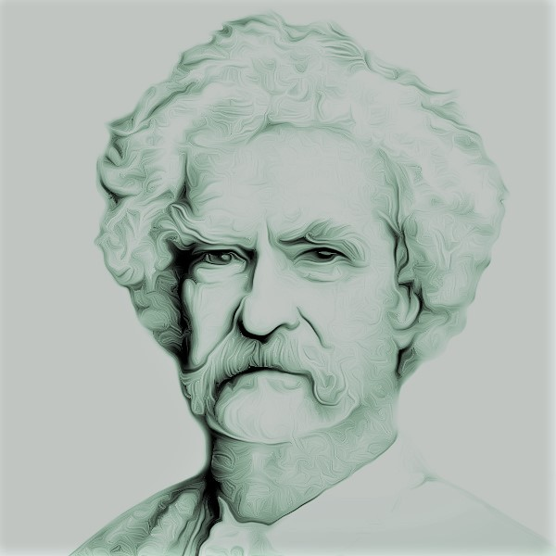
Settles in San Francisco, California
1864
Begins lecturing
1866
The Adventures of Tom Sawyer
1876
Leaves school to become a printer's apprentice
The Innocents Abroad
Founds his own publishing company
1848
1869
1884
Samuel Clemens (Mark Twain) is born
Adopts Mark Twain as pen name
Moves to Connecticut
A Connecticut Yankee at King's Arthur Court
Dies at his home in Redding
Nov 30, 1835
1857
1872
1889
Apr 10, 1910
1835
1835
1842
1849
1856
1863
1870
1877
1884
1891
1898
1905
1911
Today
1839
1859
1873
1894
Moves with family to Hannibal, Missouri
Becomes qualified steamboat pilot
The Gilded Age
Pudd'nhead Wilson (last novel)
1851
1870
1885
Takes work as typesetter
Has first child
The Adventures of Huckleberry Finn
1867
1883
Meets future wife, Livy Langdon
Life on the Mississippi (memoir)
1865
The Celebrated Jumping Frog of Calaveras County

