Slide 1
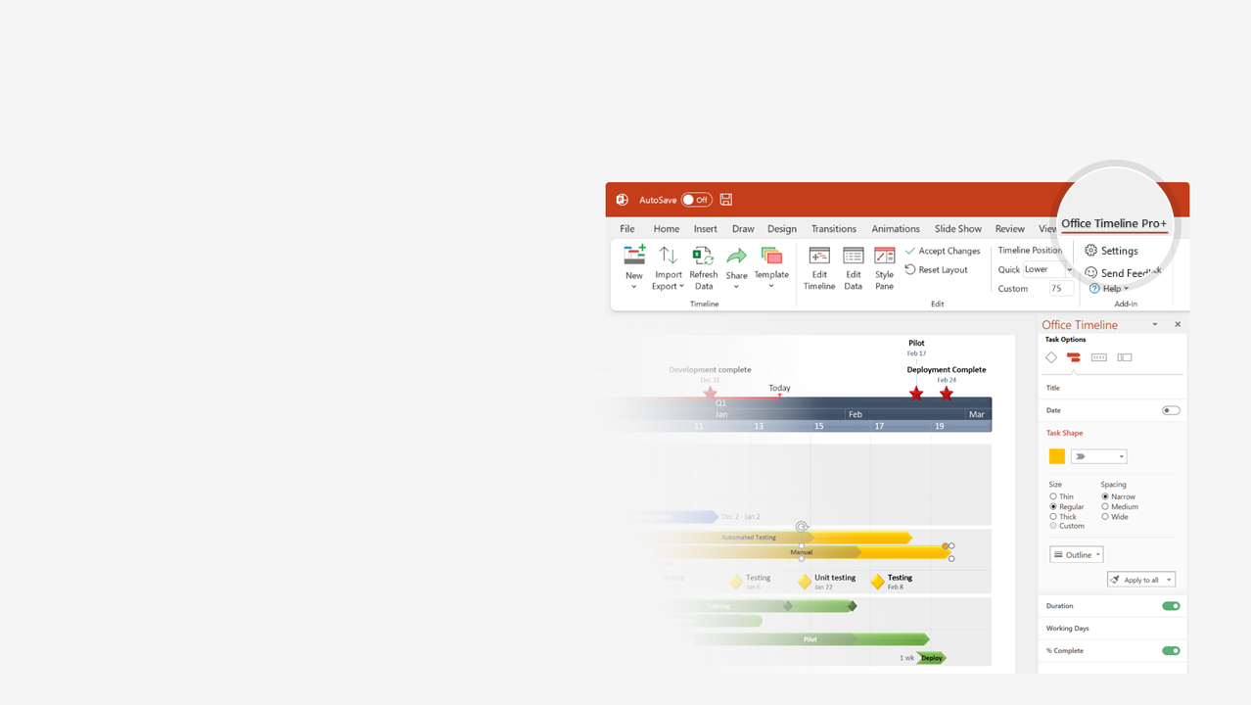

How to update this template in seconds
The Office Timeline add-in for PowerPoint will help you edit it with just a few clicks.
Get your free 14-day trial of Office Timeline here: https://www.officetimeline.com/14-days-trial Re-open this template, and create your impressive PowerPoint visual in 3 easy steps:
1
Click the Edit Data button on the Office Timeline tab.
2
Use the Data and Timeline views to edit swimlanes, milestones and tasks.
3
Click Save to instantly update the template.

Slide 2
















Timeline: How to Watch the Movies
CINEMATIC UNIVERSE
Spider-Man: Homecoming
Spider-Man: No Way Home
Avengers: Age of Ultron
Iron Man 2
Captain America: The First Avenger
Guardians of
the Galaxy
Black Widow
Thor: Ragnarok
The Avengers
Eternals
Thor: Love and Thunder
Thor: The Dark World
Captain America: Civil War
Avengers: Endgame
Iron Man
Day 1
4
7
10
13
16
19
22
25
28
Captain Marvel
Thor
Captain America: Winter Soldier
Ant-Man
Black Panther
Doctor Strange
in the Multiverse
of Madness
Avengers: Infinity War
The Incredible Hulk
Doctor Strange
Iron Man 3
Guardians of the Galaxy Vol 2
Ant-man and the Wasp
Spider-Man:
Far From Home
Shang-Chi and the Legend of the Ten Rings

Slide 3
















Bonus Timeline: How to Watch the MCU TV Shows
4
7
10
13
16
19
22
25
28
CINEMATIC UNIVERSE
Agent Carter S1
Agent Carter S2
Agents of S.H.I.E.L.D S2
Agents of S.H.I.E.L.D S3
Agents of S.H.I.E.L.D S5
Agents of S.H.I.E.L.D S1
Agents of S.H.I.E.L.D S4
Agents of S.H.I.E.L.D S6
Jessica Jones S1
Jessica Jones S2
Iron Fist S1
Iron Fist S2
Daredevil S1
Daredevil S2
Daredevil S3
Luke Cage S1
Luke Cage S2
The Inhumans S1
The Defenders S1
Cloak and Dagger S1
Cloak and Dagger S2
The Punisher S1
The Punisher S2
Loki
Wandavision
The Runaways S1
The Runaways S2
The Falcon and The Winter Soldier

