Slide 1
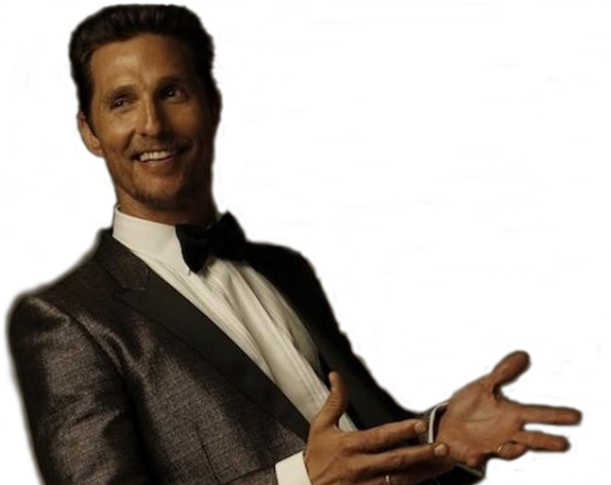
Magic Mike
2012
The Wolf of Wall Street
2013
Contact
His 1st child is born
Interstellar
1997
2008
2014
Debuts in Dazed and Confused
The Creative Conscience Award
1993
2016
Matthew David McConaughey is born
Moves to Australia for 1 year
Named 'Sexiest Man Alive' by People
His 49th birthday
Nov 4, 1969
1988
2005
Nov 4, 2018
1969
1969
1974
1979
1984
1989
1994
1999
2004
2009
2014
2018
2013
Today
1980
1993
2017
Enrols at Longview High School
Graduates from UT-Austin
Oscar for Best Actor
The Dark Tower
1996
2006
2014
A Time to Kill
Failure to Launch
True Detective
2013
Dallas Buyers Club
2012
Marries Camila Alves
2003
How to Lose a Guy in 10 Days
Life events
Films

