Slide 1
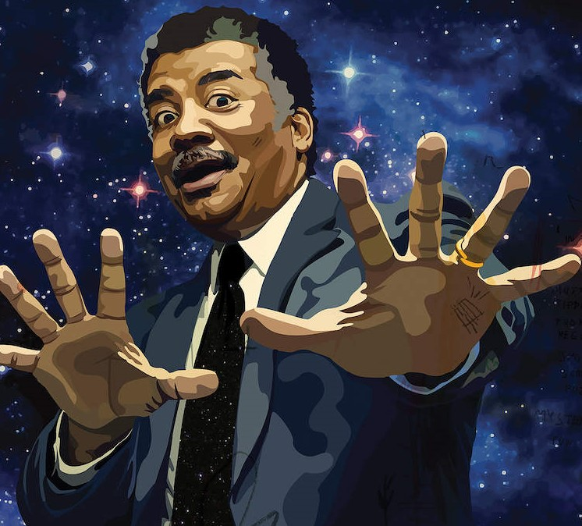

AB degree in physics from Harvard College
1980
Becomes lecturer in astronomy for the Univ. of Maryland
1986
PhD degree in astrophysics at Columbia Univ.
Launches radio talk show StarTalk
1991
2009
Becomes director of the Hayden Planetarium
1996
Becomes host of Cosmos: A Spacetime Odyssey on Nat Geo
2014
Meets Carl Sagan
Marries Alice Young
The NASA Distinguished Public Service Medal
His 60th birthday
1975
1988
2004
Oct 5, 2018
1958
1958
1965
1972
1979
1986
1993
2000
2007
2014
2020
Oct 5, 1958
1973
2001
Today
Neil deGrasse Tyson is born
Gives first astronomy lectures
Appointed to the Commission on the Future of the US Aerospace Industry
1995
2017
Begins to write the "Universe" column for Natural History
Stephen Hawking Medal
1989
2006
MPhil degree in astrophysics at Columbia Univ.
Becomes host for Nova ScienceNow program
1983
2012
MA degree in astronomy from the Univ. of Texas
Publishes "Space Chronicles"
1976
Life events
Achievements
Graduates from The Bronx High School of Science

