Slide 1
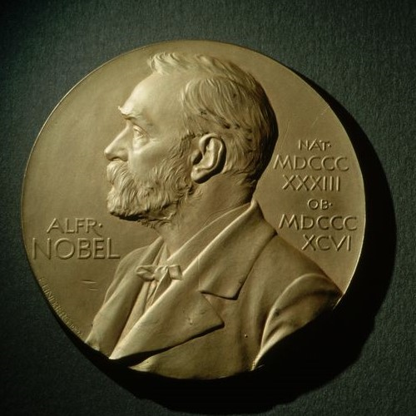
Albert Einstein proposed for Nobel Prize in Physics (awarded next year)
1921
1st imprisoned laureate, Carl von Ossietzky
1937
The most prizes (5) awarded to women
1st female laureate ever, Marie Curie (Physics)
1st winner to accept & then coerced to decline award, B. Pasternak
2009
1903
1958
Oldest winner, A. Ashkin (96)
1st year with no Nobel Prize in Medicine awarded
1st laureate to voluntarily decline the award, Jean-Paul Sartre
1915
1964
2018
1901
1901
1918
1935
1952
1969
1986
2003
2019
Dec 10, 1901
1940
1969
2014
Today
1st Nobel Prize Ceremony
No prizes awarded for 2 years
1st Nobel Prize awarded in Economic Sciences
Youngest winner, M. Yousafzai (17)
1916
1962
1st year with no Nobel Prize in Physics & Chemistry awarded
L. Pauling becomes 1st winner of 2 unshared Nobel Prizes
1931
1st Nobel Prize awarded posthumously (to poet E. A. Karlfeldt)
1914
1st year with no Nobel Prize in Literature & Peace awarded

