Slide 1
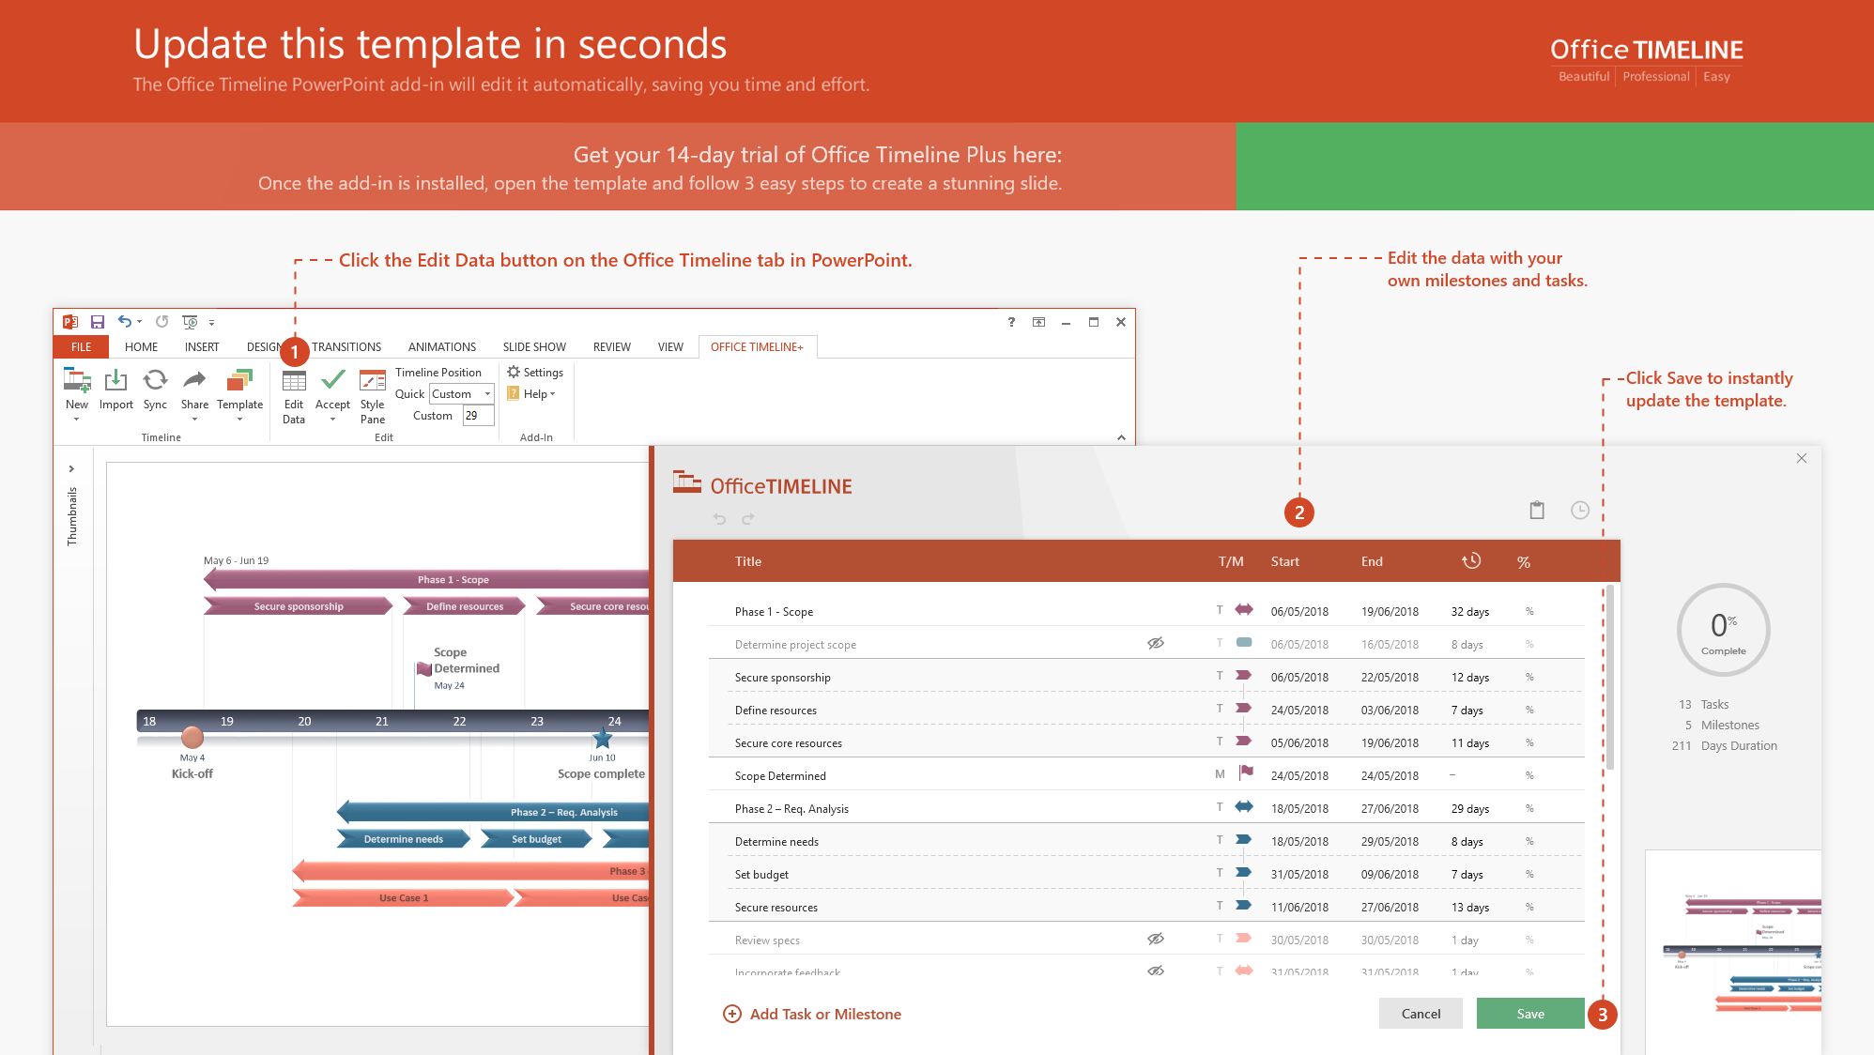
https://www.officetimeline.com/14-days-trial

Slide 2
Milestone 2
Mar 7
Milestone 3
Milestone 1
Mar 14
Milestone 4
Milestone 5
Milestone 6
Jan 10
Jun 29
Oct 20
Nov 30
2019
Jan
Feb
Mar
Apr
May
Jun
Jul
Aug
Sep
Oct
Nov
Dec
2019
Today
56 days
Task 1
Jan 5 - Mar 1
100%
41 days
Task 2
Feb 2 - Mar 14
50%
50 days
Task 3
Mar 14 - May 2
38%
210 days
Task 4
Mar 25 - Oct 20
40%
26 days
Task 4
Oct 21 - Nov 15
35 days
Task 6
Nov 16 - Dec 20

