Slide 1
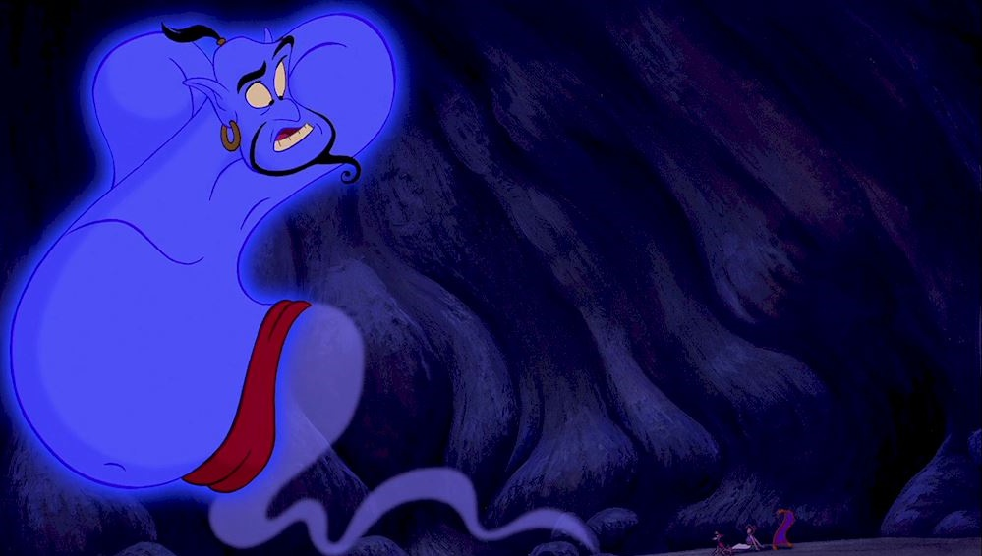
Marries Marsha Garces
1989
Jumanji
Night at the Museum
1995
2006
Accepted into Julliard
Founds Comic Relief USA
What Dreams May Come
Hospitalized. Heart surgery
1973
1986
1998
2009
First major TV role. Mork & Mindy
Hook
Bicentennial Man
Marries Susan Schneider
1978
1991
1999
2011
1951
1951
1959
1967
1975
1983
1991
1999
2007
2014
Today
Jul 21, 1951
1980
1992
2002
2007
Aug 11, 2014
Robin is born in Chicago
First movie role. Popeye
Aladdin
Insomnia
Brother dies
Dies
1978
1989
1998
2011
Marries Valerie Velardi
Dead Poets Society
Patch Adams
Broadway acting debut
1975
1987
1997
2009
Starts doing stand-up comedy
Good Morning, Vietnam
Good Will Hunting
World's Greatest Dad

