Slide 1
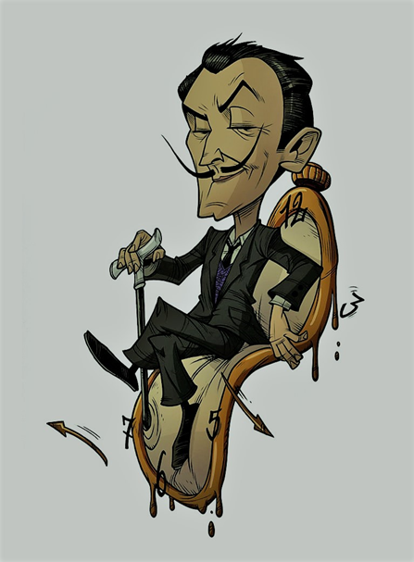
First book illustration work
1924
Expelled from the Academy
Works with Christian Dior
1926
1950
Marries Gala
1934
Begins work on the Dalí Theatre & Museum
1960
Featured on Time cover
Buys castle for Gala
1936
1968
Dalí is born in Figueres, Spain
Meets Picasso
Meets S. Freud
Designs Chupa Chups logo
May 11, 1904
1926
1938
1969
1904
1904
1912
1920
1928
1936
1944
1952
1960
1968
1976
1984
1991
Today
1925
1942
1982
His first exhibition
Publishes his autobiography
Ranked as marquess by King of Spain
1939
1969
Debuts his Dream of Venus pavilion
Works on the Eurovision ad campaign
1934
Jan 23, 1989
Banished from the Surrealist group
Dies of heart failure
1929
Joins the French Surrealist group
1922
Enrolls at the Royal Academy of Fine Arts, Madrid

