Slide 1
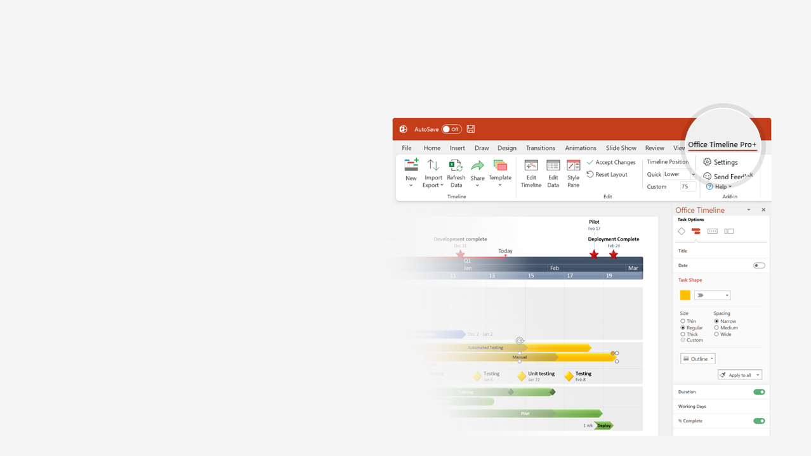

How to update this template in seconds
The Office Timeline add-in for PowerPoint will help you edit it with just a few clicks.
Get your free 14-day trial of Office Timeline here: https://www.officetimeline.com/14-days-trial Re-open this template, and create your impressive PowerPoint visual in 3 easy steps:
1
Click the Edit Data button on the Office Timeline tab.
2
Use the Data and Timeline views to edit swimlanes, milestones and tasks.
3
Click Save to instantly update the template.

Slide 2

Scrum Sprint schedule
Mar
Apr
Planning 1
Mtg 1
Mtg 2
Mtg 3
Mtg 4
Mtg 5
Backlog planning/prioritization (weekly)
Scrum
Master
Planning 2
Sprint 1
Sprint 2
Sprint 3
Sprint planning (every other week )
Planning 3
Scrum meetings (as necessary)
Planning 4
Sprint 1
Mtg 2
Mtg 4
Sprint 1
Team
Planning 5
Mtg 1
Mtg 3
Mtg 5
Sprint 1 stand-ups (every other day)
Planning 6
Sprint 1 Product demo and retrospective
Planning 7
Sprint 1 Testing
Planning 8
Sprint 2
Mtg 2
Mtg 4
Sprint 2
Team
Planning 9
Mtg 1
Mtg 3
Mtg 5
Sprint 2 Stand-ups (every other day)
Planning 10
Sprint 2 Product demo and retrospective
Planning 11
Sprint 2 Testing

