Slide 1
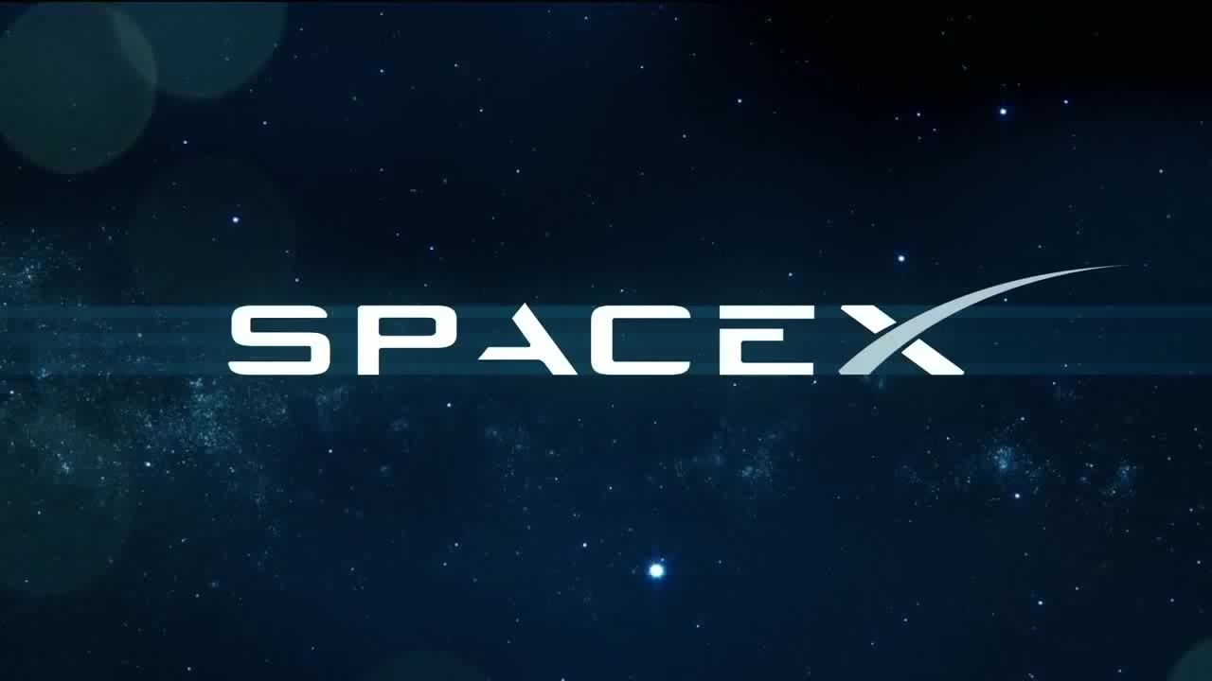
1st propulsive landing on land
Dec 22, 2015
1st spacecraft sent to ISS
Announces Interplanetary Transport System program
May 25, 2012
Sep 6, 2016
1st rocket to reach orbit
1st orbital rocket reused
Sep 28, 2008
Mar 30, 2017
Unveils largest rocket in history
Sep 6, 2017
2002
2002
2004
2006
2008
2010
2012
2014
2016
2018
2019
Today
Feb 6, 2018
Falcon Heavy launched into solar orbit
Jun 3, 2017
1st reflight of a commercial cargo spacecraft
Dec 9, 2010
Jan 6, 2017
Launches, orbits and recovers spacecraft
1st Hyperloop Competition
Dec 3, 2013
1st satellite launched into geosynchronous orbit
May 6, 2002
Apr 8, 2016
Elon Musk founds SpaceX
1st vertical landing on an ocean platform

