Slide 1
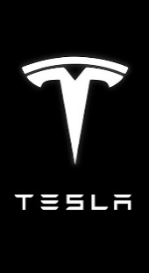
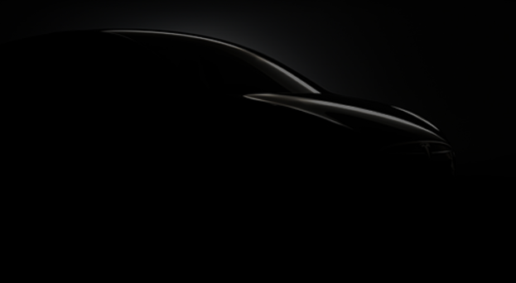
Ze'ev Drori becomes CEO and President
New Jersey bans sales of Tesla cars
Nov 2007
Mar 2014
Model S is announced
New Jersey's ban is reversed
Jun 2008
Mar 2015
Tesla raises $40 million in debt-financing
Model X is officially released
Nov 2008
Sep 2015
Tesla is founded
Tesla Factory opens in Fremont, CA
Model S sales reach 100,000 units
Jul 1, 2003
Oct 2010
Dec 2015
Series B: Elon Musk injects $13 million
Tesla takes $465 mil loan from the DOE
Model S is officially released
Tesla Motors renamed to Tesla Inc.
Feb 2005
Jun 2009
Jun 2012
Feb 2017
2003
2003
2005
2007
2009
2011
2013
2015
2017
2018
May 2006
May 2009
Feb 2012
Jun 2014
Today
Jul 28, 2017
Seriec C: $40 million
Strategic partnership with Daimler AG
Model X is unveiled
Tesla open-sources its patents
Official release of Model 3
Apr 2004
Oct 2008
Jun 2013
Feb 2017
Series A funding. Elon Musk chairman
Musk succeeds Drori as CEO
Tesla announces battery swap station
Tesla ranked as the #1 American car brand
Jun 2010
Mar 2016
Tesla goes IPO at $17 per share
Model 3 is unveiled
Mar 2008
Oct 2015
The Roadster enters production
Autopilot introduced for Model S
Apr 2015
Tesla Powerwall is announced
Company
Products

