Slide 1
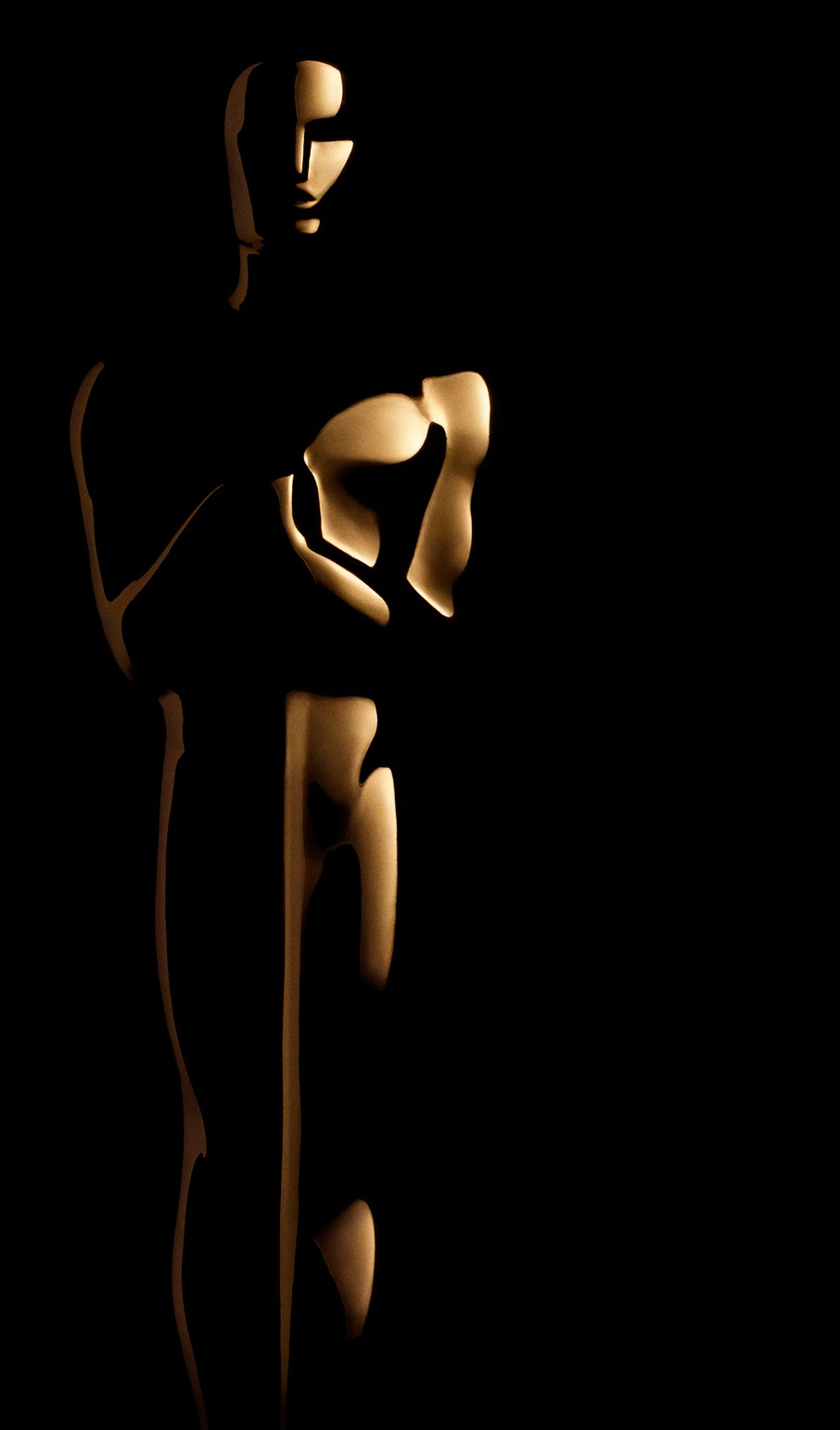
1st Academy Awards ceremony
May 16, 1929
Shirley Temple: youngest person to get an Oscar
Shortest speech, by A. Hitchcock
Longest televised ceremony
1934
1968
2002
Longest speech ever, by Greer Garson
C. Chaplin receives longest standing ovation in the ceremony's history
1st female director to win an Oscar
1942
1972
2010
1st televised ceremony
1st deaf actress to win an Oscar
Most diverse voting list ever
1953
1987
2018
1929
1929
1938
1947
1956
1965
1974
1983
1992
2001
2010
2018
1943
1966
2016
Today
A 45-second speech limit is instituted
1st edition telecast in color
John Williams: most nominated person alive
1939
1978
2008
1st black actress to win an Oscar
Maggie Smith gets Oscar for playing a failed Oscar nominee
Lowest TV ratings ever recorded
1930
1970
1998
Only 7 categories to be awarded
The only X-rated movie to ever win an Oscar
Gloria Stuart, 87: oldest person nominated

