Slide 1
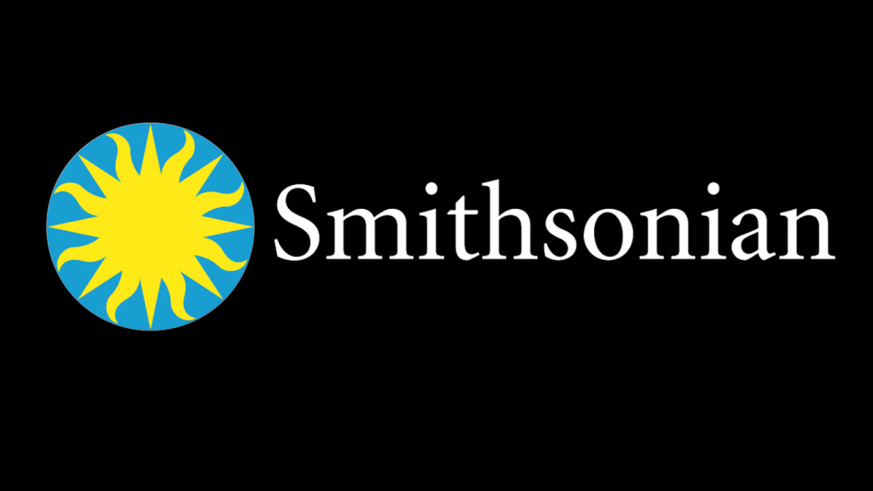
The National Museum of African American History & Culture
2016
The Museum of History & Technology
1st capital fundraising campaign undertaken
1964
2011
The Smithsonian American Art Museum
1968
Is established by the US Gov.
The National Zoological Park
The National Museum of African Art
Aug 10, 1846
1889
1987
Its official opening
The Langley Gold Medal is authorized
The Smithsonian Latino Center
1855
1909
1997
1846
1846
1871
1896
1921
1946
1971
1996
2020
1965
Today
1849
1911
Aug 10, 2018
Its construction begins
The National Museum of Natural History
The James Smithson Medal is established
Its 172nd anniversary
1893
1993
The Hodgkins Medal is established
The National Postal Museum
1881
2004
The Arts & Industries Building
The National Museum of the American Indian
Main events
Main museums & centers
1976
2015
The National Air & Space Museum
The 1st overseas exhibition space announced

