Slide 1
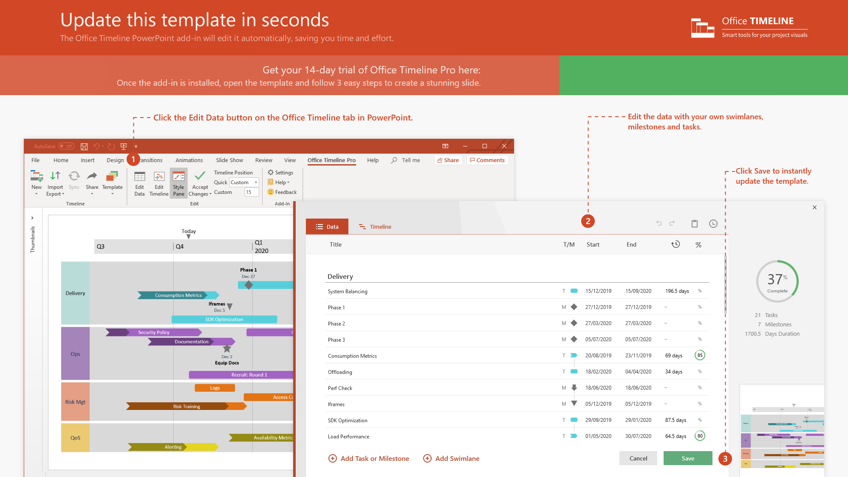
https://www.officetimeline.com/14-days-trial

Slide 2

Investment organization build-out plan
Q2
Q3
Q4
Q1
Apr
May
Jun
Jul
Aug
Sep
Oct
Nov
Dec
Jan
Feb
Mar
100%
Goals & Objectives
Risk Status
High
Medium
Low
100%
Preliminary Approval
Research
100%
Sector Investment Opportunities Research
100%
Prepare Summary Report
Present Summary Report
100%
Obtain Go/No Go Approval
100%
Organizational Development Plan
100%
Search & Hire Director
CFO Change Delays Decision
80%
Establish Budget & Get Approval
Organizational
Development
Hire First Staff Member
Staff Training
100%
Sector Investment Plan
20%
Hire Second Staff Member
Conduct Second Staff Training
Key Risks:
1. Org. changes at CFO level
2. Delays in team hiring plan
Update Sector Investment Plan
Begin Operations
Project two- month delay
Potential Recovery Points:
1. Shorten training time
2. Accelerate completion of sector investment plan
Sector Investment Research
Operations
Investment Review
Make Initial Investments
Made with
Performance Review
Decision to Continue/Terminate

Slide 3
Apr 22 - May 17
May 20 - May 24
May 27 - May 31
Oct 21 - Oct 25
Oct 28 - Nov 22
Nov 25 - Dec 20
Dec 24 - Dec 25
Apr 1 - Apr 26
Jun 10 - Jul 5
Jul 8 - Jul 26
Jul 29 - Aug 9
Aug 12 - Sep 6
Oct 7 - Oct 18
Nov 4 - Dec 13
Apr 8 - May 3
Jun 3 - Jun 7
Sep 9 - Oct 4
18 days
18 days
18 days
18 days
13 days
18 days
18 days
18 days
18 days
28 days
3 days
3 days
3 days
8 days
8 days
3 days
0 days
Jun 10
Oct 25
Dec 20
Dec 23
Dec 25
Feb 20
Apr 17
Apr 17
Jun 3
Aug 9
2022
2023
Today
2022
2023
Jan
Mar
May
Jul
Sep
Nov
Jan
Mar
May
Jul
100%
Review Financial History and Funding Requirements Plans
Resources
Board of Directors
Consultant
Finance Department
Government
Purchasing Department
Senior Management
100%
Review other Operations, Marketing, Personnel, and Facilities Plans for Consistency
100%
Determine Funds Needs and Timeframe
Pre-planning
100%
Review and Coordinate with Senior Management
100%
Build Presentation for Board of Directors
Present to Board of Directors
100%
Post Board of Director's Meeting Guidance Implementation
Go/No Go Decision
Create Requirements Package for Financial Consultant
First Quiet Period
Second Quiet Period
Detail-planning
Select and Orient Financial Consultant
Create IPO Detailed Plan
Review Number 1
Investigate Commercial Sources
Gather support
Conduct Interviews
Negotiate Contract, Conduct Kick Off Meeting
Review Financial Preparations for Start of IPO
Review Number 2
Filings
Regulatory Q&A
Obtain Approval to Proceed with IPO
IPO Schedule
Timeline
Review Number 3
Media cover begins, but release of earnings forecast is restricted.
Execution
Promotional Materials
Media Presentations
IPO Start Date
First Day of Public Trading
Research Coverage Begins
Made with
Issue First Earnings Forecast

Slide 4
Venture Capital Timeline
2019
2020
2021
2022
2023
2024
2025
2026
2027
2028
2029
2030
InstaPress
Key Events
Acquisition
Bankruptcy
Follow-on Investor
IPO
Lead Investor
No Participation
Series A - $84MM
B - $50MM
Uno Wear
Series A - $22MM
B - $11MM
$400MM Acquisition
Allure Kit
Series A - $13MM
$300MM Acquisition
Swish Wallet
Series A - $32MM
B - $31MM
C - $30MM
D - $75MM
E - $19MM
Onovo Supply
Series A - $80MM
B - $52MM
Sharpy Knife
Series A - $17MM
B - $18MM
$220MM Acquisition
Towlee
Series A - $18MM
B - $82MM
C - $67MM
$2.5B IPO
Rhino Case
Series A - $58MM
$600MM IPO
Mono
Series A - $10MM
B - $43MM
C - $30MM
D - $43MM
ONEset
Series A - $66MM
B - $75MM
Liquidation
Vortex
Series A - $84MM
B - $38MM
C - $84MM
Made with
Villafy
Series A - $12MM
Liquidation

Slide 5
Regional Branch Bank Expansion Program Schedule
Today
2020
2021
2022
Q1
Q2
Q3
Q4
Q1
Q2
Q3
Q4
Q1
Q2
Q3
Q4
Review of previous expansion
Consolidate lessons learned
Antitrust litigation
Resources
Corporate
Consultants
Program Planning
Draft guidance
Internal review
Finalize guidance
Guidance approval
Official Program Launch
Assemble market research teams
Planning guidance
Consolidate research results
5-year plan approval
Program Overview
Preliminary market analysis
Regional projections
Regional budgeting
Planning
5-year expansion program preliminary execution
70%
Expansion teams
Regional market research
Land acquisition delays
Regional expansion targets
Prioritize locations
West Region
65%
Regional Expansion
East Region
70%
Made with
North Region
80%
South Region
75%

