Slide 1
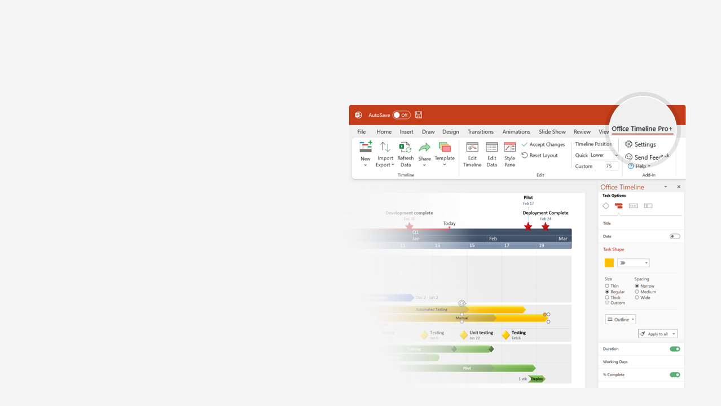

How to update this template in seconds
The Office Timeline add-in for PowerPoint will help you edit it with just a few clicks.
Get your free 14-day trial of Office Timeline here: https://www.officetimeline.com/14-days-trial Re-open this template, and create your impressive PowerPoint visual in 3 easy steps:
1
Click the Edit Data button on the Office Timeline tab.
2
Use the Data and Timeline views to edit swimlanes, milestones and tasks.
3
Click Save to instantly update the template.

Slide 2
Fiber Installation Timeline
2021
2022
2023
2024
Q3
Q4
Q1
Q2
Q3
Q4
Q1
Q2
Q3
Q4
Q1
Q2
Today
Phases
Planning/Permitting
Lay Fiber
Network Testing
Upgrade Live
FCC Review
Houston Market
Planning/Permitting
Lay Fiber
Network Testing
100%
100%
100%
Upgrade Live
Seattle Market
Planning/Permitting
Lay Fiber
Network Testing
New Construction
80%
Upgrade Live
Phoenix Market
Planning/Permitting
Lay Fiber
Network Testing
100%
100%
100%
Upgrade Live
Portland Market
Planning/Permitting
Lay Fiber
Network Testing
Upgrade Live
Houston Market
Planning/Permitting
Lay Fiber
Network Testing
80%
Upgrade Live
Seattle Market
Planning/Permitting
Lay Fiber
Network Testing
Network Upgrades
70%
Upgrade Live
Phoenix Market
Planning/Permitting
Lay Fiber
Network Testing
Right-of-way acquisition delay
100%
100%
100%
Upgrade Live
Made with
Portland Market
Planning/Permitting
Lay Fiber
Network Testing
100%
40%
Upgrade Live

Slide 3
Merger & Acquisition Integration Schedule
2021
2022
2023
Q1
Q2
Q3
Q4
Q1
Q2
Q3
Q4
Q1
Q2
Jan
Apr
Jul
Oct
Jan
Apr
Jul
Oct
Jan
Apr
Shareholder Approval
Today
Integration Complete
Select Consulting Firm
100%
100%
Organizational Analysis
Organizational Integration
$10,224,000
Design New Org Structure
100%
100%
Executive Relocation
100%
Implement New Org Structure
75%
Key Employee Relocation
Brand Integration
Select Marketing Firm
100%
100%
Market Analysis
$6414,000
Develop New Branding
100%
100%
Rebrand New Markets
100%
Rebrand Legacy Markets
Internal Gap Analysis
90%
Billing System Design
Systems Integration
Provisioning System Design
$19,800,000
Billing System Implementation
Provisioning System Implementation
Billing/Provisioning Integration
Legacy System Sunset & Conversion
Product Integration
Product Alignment
100%
100%
Develop New Products
$12,540,000
70%
Sunset Legacy Products
80%
Launch New Products
Facilities Integration
Facilities Planning & Analysis
100%
100%
Hire Real Estate Firm
Made with
$4,386,000
100%
Dispense of Excess Real Estate
60%
Consolidate Facilities

Slide 4
Telecom Product 5-year Roadmap
2022
2023
2024
2025
2026
2027
UP-21
SJ-19
ZL-26
BI-2
Voice
QY-17
JG-10
IU-9
RP-18
Consumer
Video
QB-17
HX-8
ZL-28
Data
LK-12
YM-25
GZ-7
UY-21
Security
YS-25
SW-19
HR-8
GN-7
Voice
Small & Medium Business
PN-16
GF-7
ZO-26
CR-3
Video
TH-20
DA-4
AN-1
Data
HP-8
JW-10
VE-22
TC-20
Security
WT-10
KZ-11
XO-24
OC-15
IX-13
UO-21
Enterprise
Voice
Made with
TN-20
VD-22
MQ-9
VR-22
QC-17
Data

