Slide 1
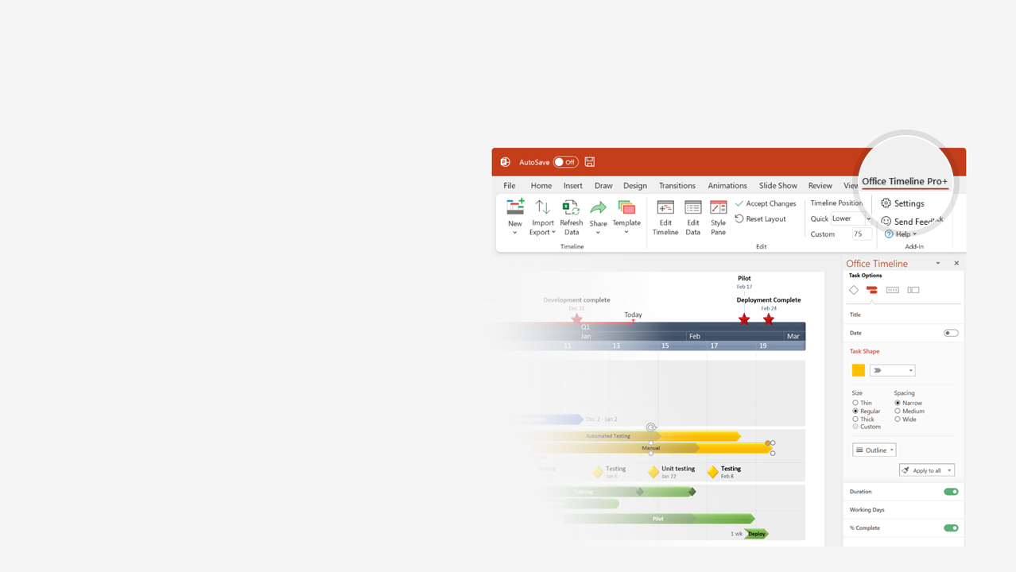

How to update this template in seconds
The Office Timeline add-in for PowerPoint will help you edit it with just a few clicks.
Get your free 14-day trial of Office Timeline here: https://www.officetimeline.com/14-days-trial Re-open this template, and create your impressive PowerPoint visual in 3 easy steps:
1
Click the Edit Data button on the Office Timeline tab.
2
Use the Data and Timeline views to edit swimlanes, milestones and tasks.
3
Click Save to instantly update the template.

Slide 2



John & Jane
Wedding Timeline
Ceremony begins
Newlyweds grand entrance
Photographer arrives
16:00
Couple's exit
12:30
17:45
23:00
Sunday 29 Feb ‘24
10:00
11:00
12:00
13:00
14:00
15:00
16:00
17:00
18:00
19:00
20:00
21:00
22:00
Hair & Makeup
10:00 - 12:30
Everyone gets dressed
Pre-ceremony
13:00 - 14:00
First look
Couple portraits
Wedding party portraits
Family portraits
45 m
Travel to ceremony venue
Cocktail hour
16:30 - 17:30
Guests enter reception
First dance
Welcome toasts
Post-ceremony
Dinner
18:30 - 19:15
19:30 - 20:15
Family dances
Bridal party toasts
Cake cutting, bouquet toss
Open dance floor
20:30 - 22:45
Last dance

