Slide 1
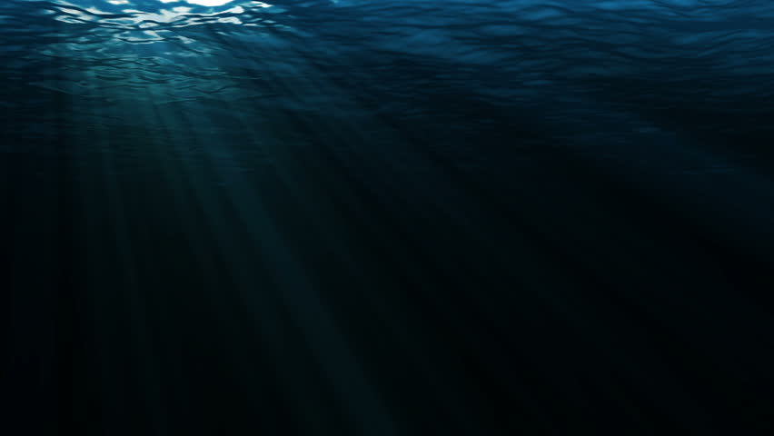

"Youth: The Next Wave of Change"
"Healthy oceans, healthy planet"
06/08/15
First Official World Oceans Day
“Our Oceans, Our Responsibility”
06/08/12
"Together we have the power
to protect the ocean (II)"
"Our Oceans, Our Future"
06/08/09
06/08/14
06/08/17
"Oceans of Life: Pick your favorite, Protect your favorite."
"Healthy Oceans, Healthy Planet (II)"
06/08/10
"Together we have the power to protect the ocean."
06/08/16
"Protect your favorite (II)"
06/08/11
06/08/13
2008
2008
2009
2010
2011
2012
2013
2014
2015
2016
2017
2017
06/08/10
06/08/14
06/08/16
Today
Over 300 events in 45 countries
700 hundred events, Twitter reach doubled
700 events, WOD trended second on Twitter
06/08/09
06/08/15
Over 200 events worldwide
06/08/12
Nearly 1000 events worldwide
12/31/08
Over 500 events in 55 countries
8 June officially designated as World Oceans Day
06/08/13
Over 600 events worldwide
WOD Themes
WOD Achievements

