Slide 1
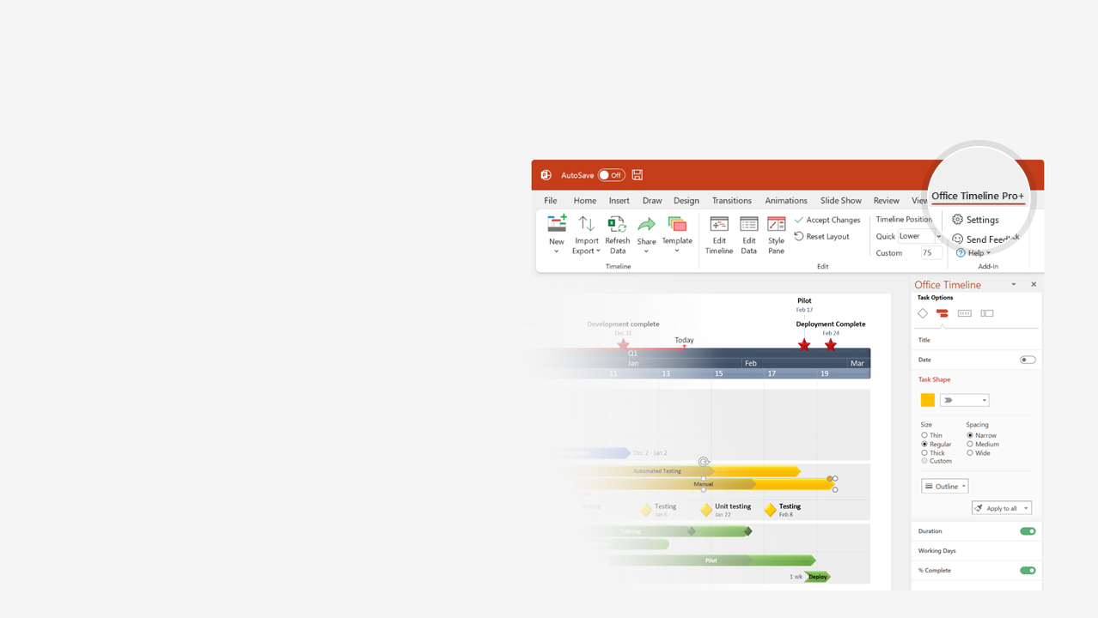

How to update this template in seconds
The Office Timeline add-in for PowerPoint will help you edit it with just a few clicks.
Get your free 14-day trial of Office Timeline here:
https://www.officetimeline.com/14-days-trial
Re-open this template, and create your impressive
PowerPoint visual in 3 easy steps:
1
Click the Edit Data button on the Office Timeline tab.
2
Use the Data and Timeline views to edit swimlanes, milestones and tasks.
3
Click Save to instantly update the template.

Slide 2
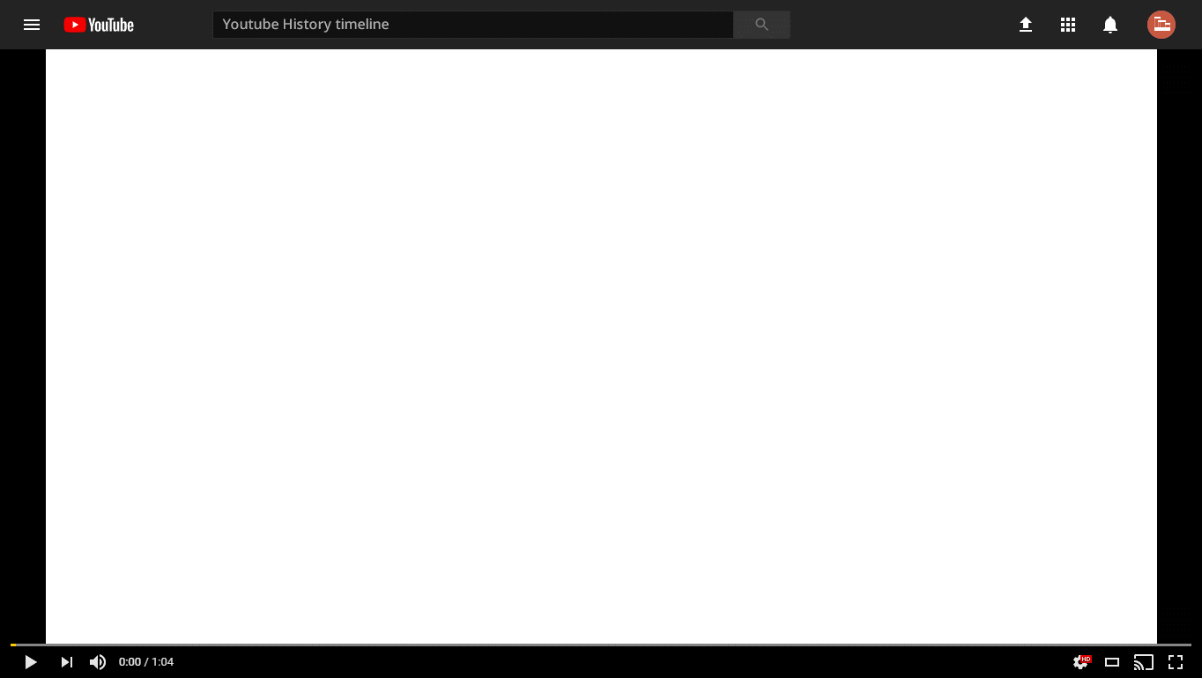

YouTube history timeline
YouTube.com registered
2005
Official launch
Peabody Award
Becomes second most popular
social network worldwide
2005
2009
Acquired by Google
1 billion views/day
First 1 billion-hit video
Buys $215 million office park
Removes categories
2022
2006
2009
2012
2016
2020
2005
2007
2009
2011
2013
2015
2017
2019
2021
Vevo (in partnership with Vivendi)
60 fps videos are introduced
New logo for the first time
Video Reach advertising platform
2009
2014
2017
2018
In-video ads
YouTube Rentals
YouTube Live
YouTube Red
YouTube Red rebranded
as YouTube Premium
Creator Studio phased out
2007
2010
2011
2015
2018
2019
Filtering launched
YouTube Go
YouTube TV
YouTube Go shutting down
2006
2016
2017
2022
YouTube's Partner Program
Turkey bans YouTube for the 2nd time
YouTube headquarters shooting
2007
2014
2018

